Slide 1
Reinforcement learning

Slide 2
Reinforcement Learning
Reinforcement Learning(RL) is a type of machine learning technique that enables an agent to learn in an interactive environment by trial and error using feedback from its own actions and experiences.

Slide 3
Application of Reinforcement Learning
Automated Robots
Gaming
Autonomous cars
Traffic light control

Slide 4
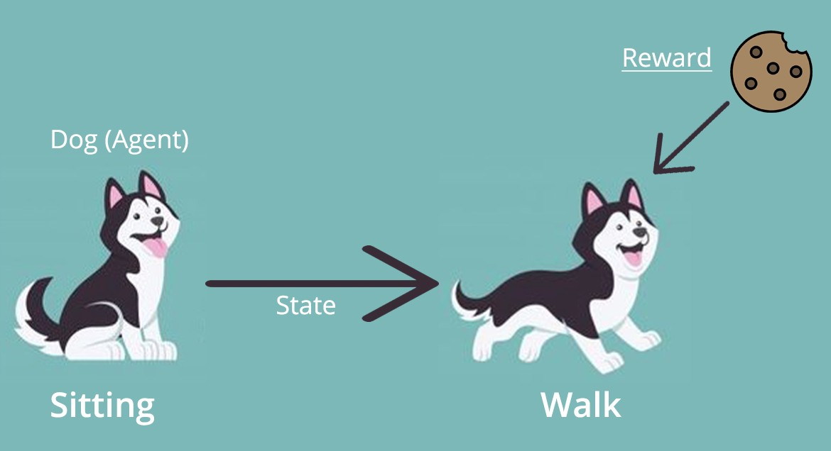
Let’s understand by an example

Slide 5
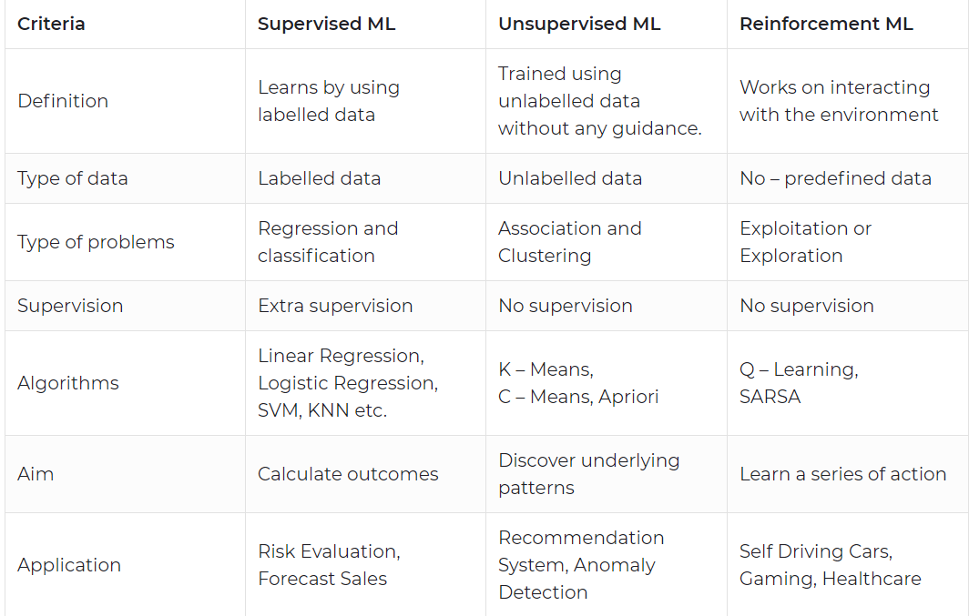
Supervised Vs Unsupervised Vs Reinforcement Learning

Slide 6
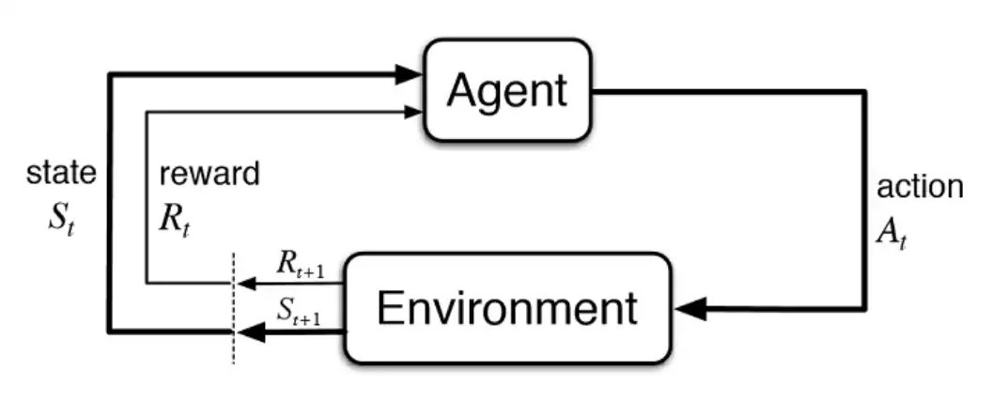
Reinforcement Learning Terminology
Agent :The learner and decision-maker
Environment :The thing it interacts with, comprising everything outside the agent
Action : The mechanism by which the agent transitions between states of the environment

Slide 7
Other Terms
State : A state in reinforcement learning is a representation of the current environment that the agent is in. This state can be observed by the agent, and it includes all relevant information about the environment that the agent needs to know in order to make a decision.
Reward : The agent is rewarded for taking controls that lead to successful states. The rewards can be immediate, such as receiving a point for each step taken in the right direction, or they can be delayed, such as receiving a point at the end of the episode if the goal was reached.
Policy: It is a mapping from the current environment observation to a probability distribution of the actions to be taken. During training, the agent tunes the parameters of its policy approximator to maximize the long-term reward.

Slide 8
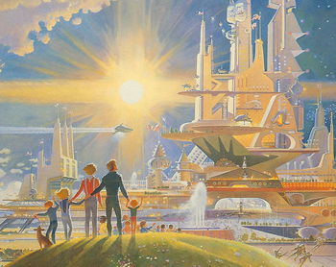
Assignment
What’s your definition of the Ideal world ?

Slide 9
Well, personally, I believe that Ideal world is a world is where there exists no gender and ethnic discrimination.

Slide 10
Task 1
Using linear regression model, predict the income for both the worlds and check for feature importance (using coefficients value). Check if there is any gender or ethnic discrimination when building the model for predicting income. Find out which of the 2 worlds is closer to being fair or being Asgard.
Just predicting income wont help you in understanding bias in society

Slide 11
Task 2
Now we have the ideal world from Task 1. Your next task is to use the various modeling techniques on this world and find out the best fit model for this world.
Task 3
Now that we have the best fit model, all we need to do is publish it! Your next task includes hosting and deploying this best fit model on your localhost machine and make sure everything is set up the way we want it to be.

Slide 12
Questions ?

